Slide 1

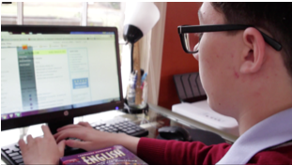


Learn to Navigate the School site with ease
Please follow the instructions to find your live classes, courses, and plans. Depending on the number of students you have in ARVA and whether you are in the student or learning coach account, your screen may look slightly different.

Slide 2
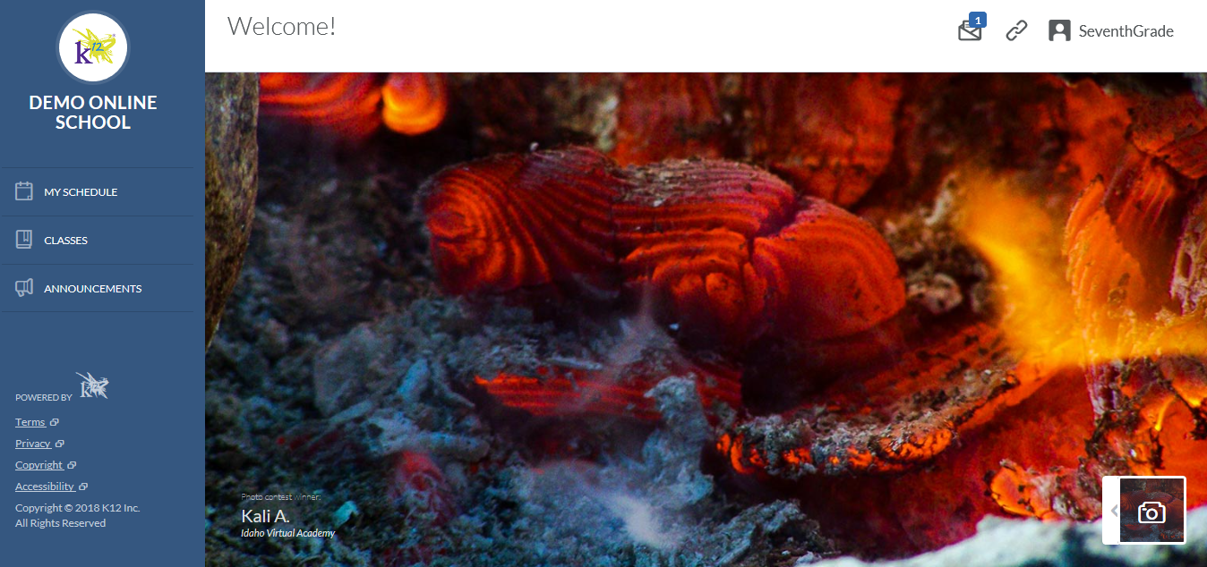
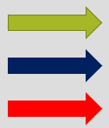
This area will display your student’s name, account settings and the link their school email.
Student’s Homepage
Homepage
Homepage
SCHEDULE: This will be where you click to find you live classes in the Blackboard Collaborate with your teachers.
CLASSES: This will be where you click to find your courses. You will select a course and enter the course to complete the daily lessons/assignments.
ANNOUNCEMENTS: This will be where you click to find school wide announcements.

Slide 3
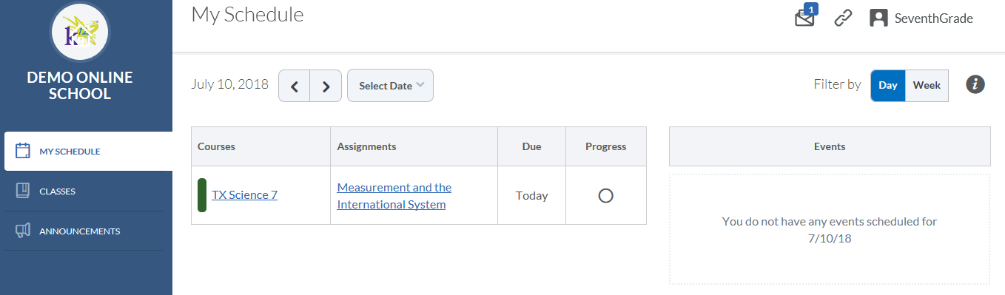

Look here to see a different view by week and for any overdue assignments.
MY SChedule
Change the date here.
These are the day’s lessons at a glance. It is good to look here and see what is due each day. However, if the student is only logging in through this link, they could miss some important information needed for tests. I will show you later where to look for a better view. Also, the times here are for when it appears on the plan. It may or may not be the CLOSE DATE.
These are the LIVE classes in BBC. If you have trouble logging in to the session, check to see that you are logging in within 15 minutes before the start time. Sometimes the teacher will lock the class after 10 minutes and will not allow the student to enter the session late.

Slide 4
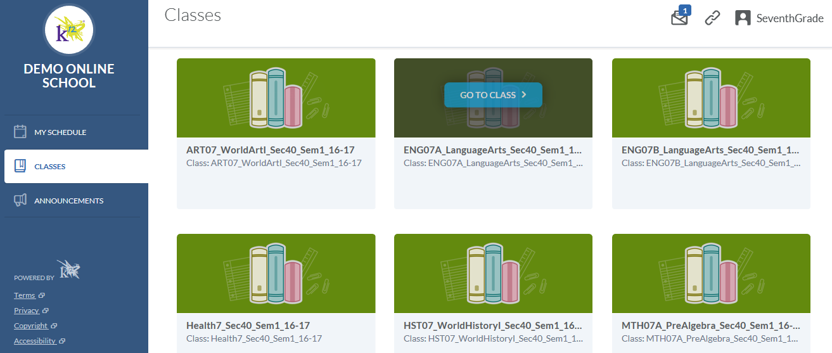
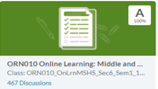
CLASSES
CLASSES
Start with this course. It takes about 1 hour to complete the course and should be completed within the first few days of starting school. It MUST be completed in the STUDENT account with BOTH the student and Learning Coach. This course will show you some very important tools to be successful. PLEASE make completing this course a top priority.

Slide 5
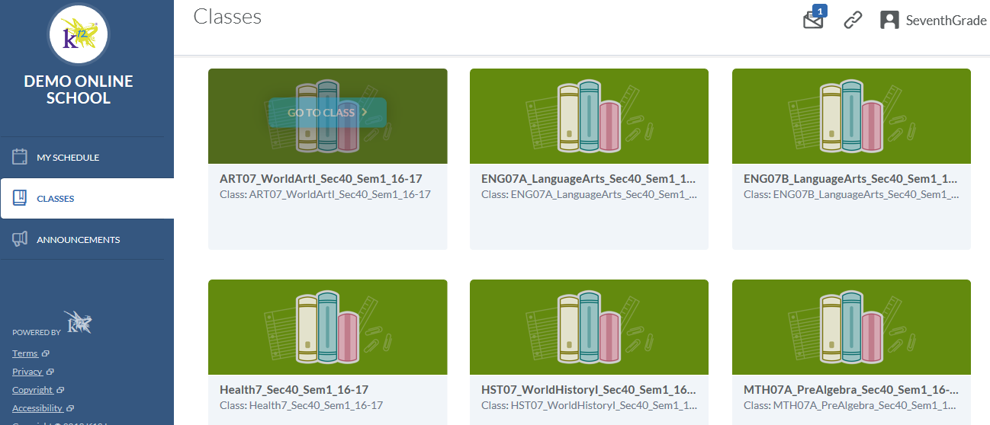
How to access the courses, Lessons and Assignments:
Select the course you want to go into. By clicking on the course box. It will take you to another screen with only the information for that course. See the next page for more information.

Slide 6
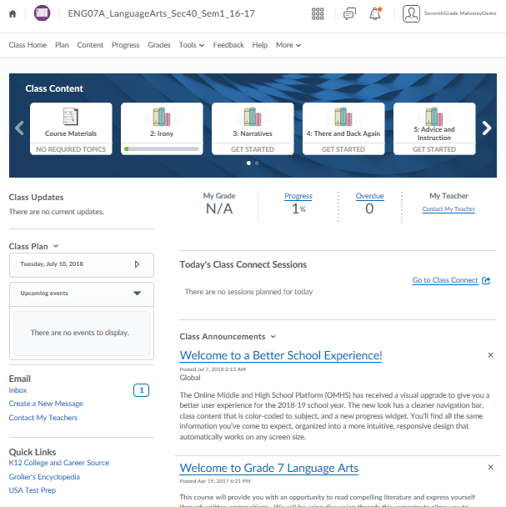

Click here to change courses.
Course Homepage
The student’s name will be here. If the Learning Coach is viewing as the student it will say “Impersonating”. NO WORK should be completed in this view. Log out and log in as the student. No credit will be given for work completed in the student view and will have to be completed again in the correct view.
Click here to return to the homepage.
Another way to view the daily plan in the course.
Who your teacher is, grade in the course, how much of the course is completed and overdue assignments.
LIVE Class Connects in BBC.
Access email inbox, send email, contact your teachers.
Important messages from your course teacher. Check DAILY.

Slide 7
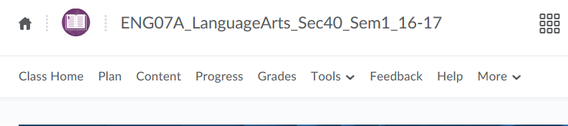
What about these?
FEEDBACK: K12 welcomes your feedback on our curriculum - your comments and suggestions will help us improve our program.
Course Navigation Bar Links
CLASS HOME: The main page of the course where you get an overview of the course.
CONTENT: This is where you will find the coursework (Units/ Lessons) to complete.
GRADES: This is where you will find the grades from assignments completed or ZEROS entered on Mondays for missing assignments.
Click here to change courses.
PLAN: This is where you will find the best way to view your course plans. More to come later.
PROGRESS: Check your student’s progress here. There are multiple views to look at.
TOOLS: Check to see that the Teacher Graded Assignments have been submitted, Discussions have been completed, and more.
HELP: Click here for helpful links for both student and Learning Coach and for Customer Support info.

Slide 8
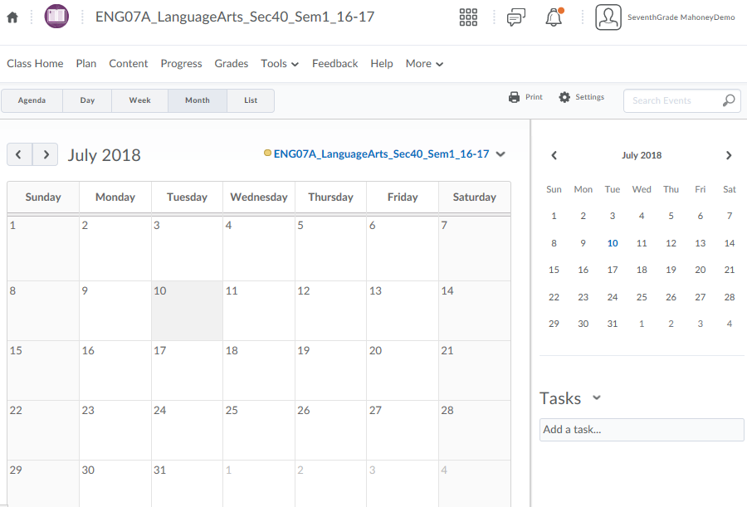
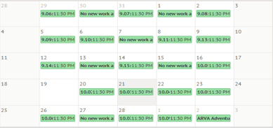
Course Plan View
You can print the view you prefer and have a checklist for the student to follow. Once a lesson/ assignment is completed, the student can mark it off the printed copy to make sure it is all completed.
Different views to see the course plan. Choose your favorite. Mine is the monthly view.
Course Plan View
Here is where you find what assignments are due each day. You can hover or click the assignment and see what the unit/lesson number is and if it is due by a specific time.
Change courses here to keep from having to go all the way back to the Homepage.

Slide 9
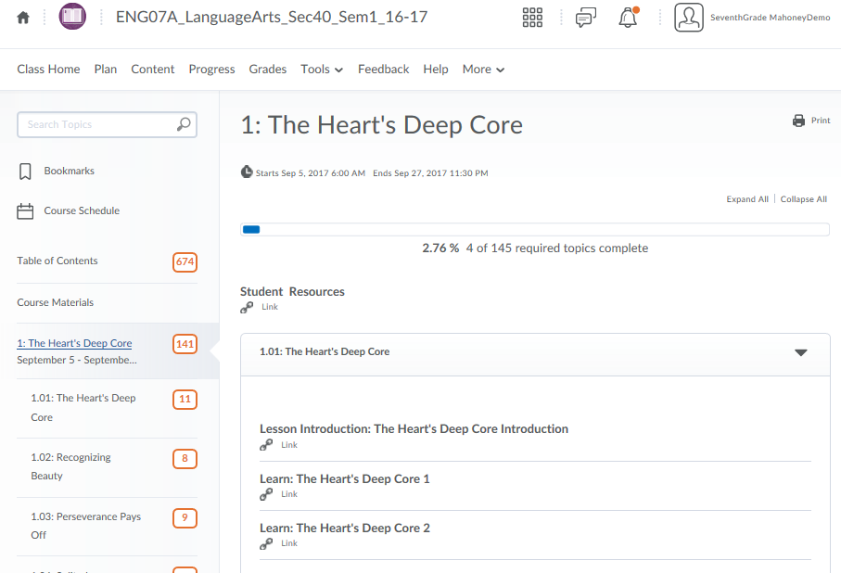
CONtent view
CONtent view
Table of Contents, Course Materials (Syllabus and other important information), and Unit/Lesson lists.
Unit number and progress in the unit
UNIT. LESSON number (as listed in the PLAN view)
Unit.Lesson, Due Date (if there is one), Check marks appear when completed.

Slide 10
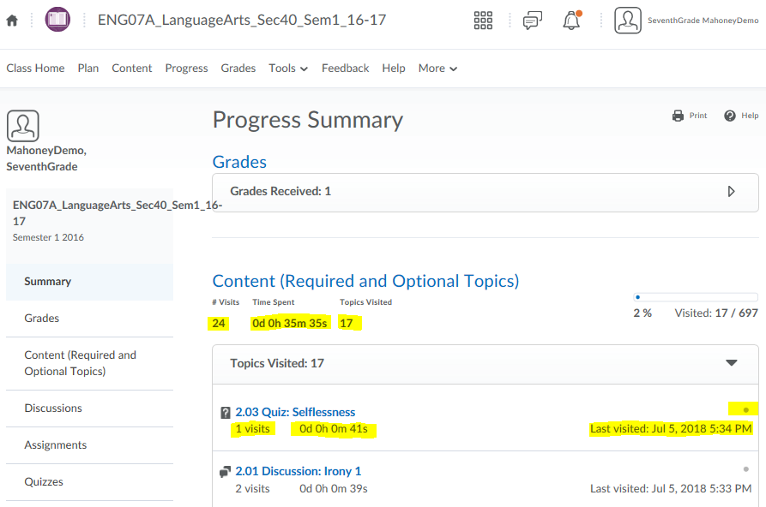
Progress View
(Learning Coaches best view for attendance time)
Progress View
(Learning Coaches best view for attendance time)
This view has lots of good information in it for the Learning Coach. If you scroll down in the center of the screen look for CONTENT (REQUIRED AND OPTIONAL TOPICS). Here you will be able to see how much time the student spends on EACH part of EVERY ONLINE LESSON and MOST ASSIGNMENTS. If you are concerned your student is not spending enough time on the lessons, this view will help gain a better view of what is actually being done. However, TEACHER GRADED ASSIGNMENTS and OFFLINE work is not always calculated.
DOTS= NOT completed
CHECK MARKS=completed

Slide 11
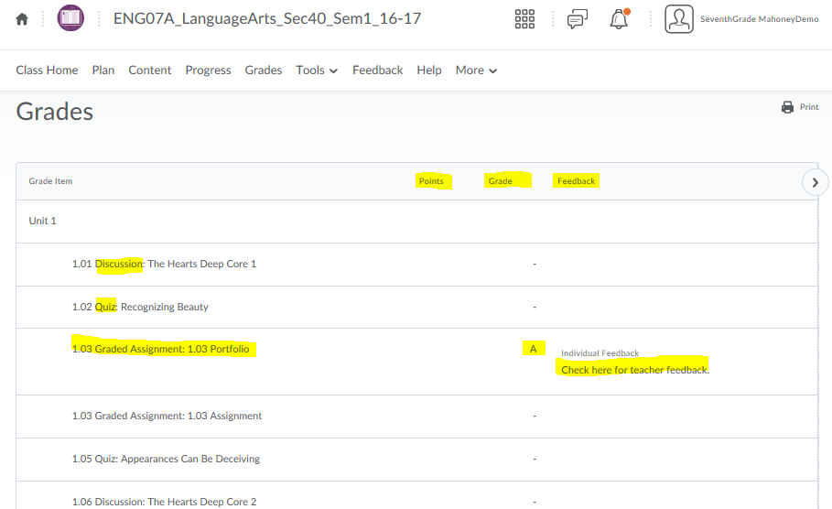

GRADES VIEW
Correct/Total Points
Letter Grades:
If a student would like to/needs to improve their score, they MAY have extra attempts available on some assignments. Check the assignment to see if more are available or check with the course teacher. EXEMPT assignments are NOT required.
Types of Assignments:
*BONUS
*ASSESSMENTS
*QUIZZES
*PART 1: (Computer Graded Unit Tests)
*PART 2: (Teacher Graded Offline Tests)
*TEACHER GRADED ASSIGNMENTS
Teacher Feedback: Click here for teacher directions and comments regarding graded assignments.

Slide 12
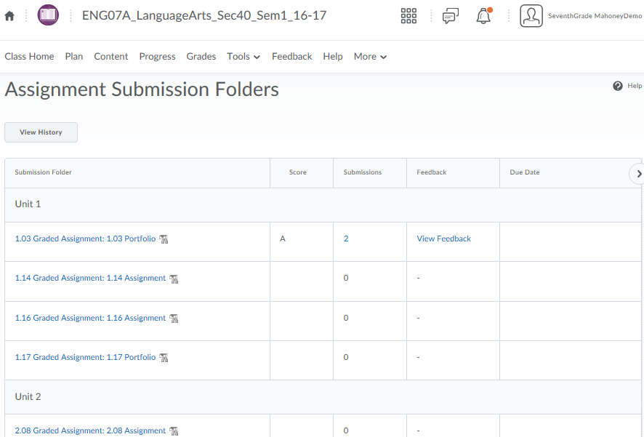

Click the Dropbox and select Assignments to see this view.
TOOLS/ ASSIGNMENTS View
Grade received for the assignment
Number of times student submitted assignment. Click on number to view actual submission. O=none turned in
TEACHER GRADED ASSIGNMENTS:
Assignments turned in to the teacher for grading. These include Part 2 Assessments, Science Labs, Language Arts Essays and other Projects.
Teacher Feedback for the assignment
Due Date for the assignment (if it has one)

Slide 13
THIS Concludes the presentation. Please Let me know if you need additional help or have any questions. I hope this helps you to be able to navigate a little easier through the online school. Have a great day!
-Mrs. Crystal Clayborn
THIS Concludes the presentation. Please Let me know if you need additional help or have any questions. I hope this helps you to be able to navigate a little easier through the online school. Have a great day!
-Mrs. Crystal Clayborn

