Slide 1
ORN010 Help Session
This Course is required to be completed in the STUDENT account by both the student and the Learning Coach together. This course will help prepare you for how your courses will work and get you better equipped for success in ARVA. The course should be completed BEFORE your start date if possible or within your first week to ensure you have all the tools and information you need. Thanks for coming in! ☺

Slide 2
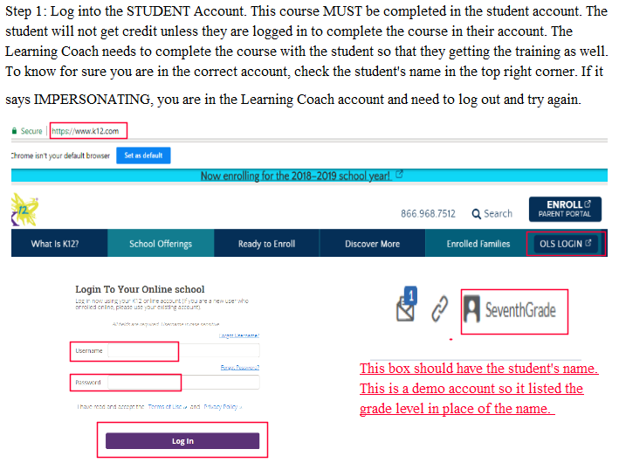

Slide 3
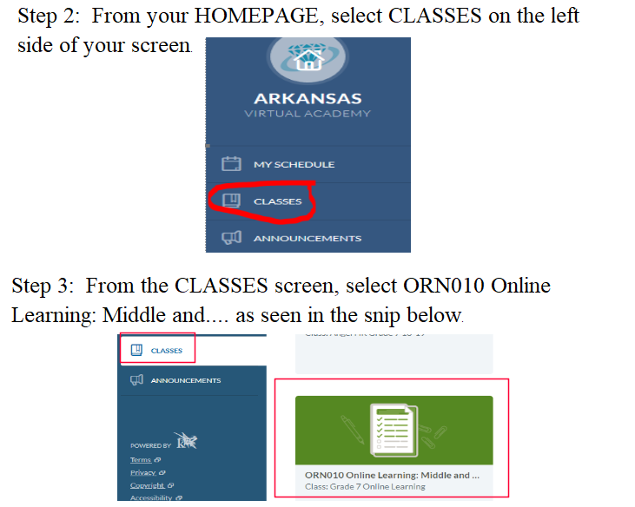

Slide 4
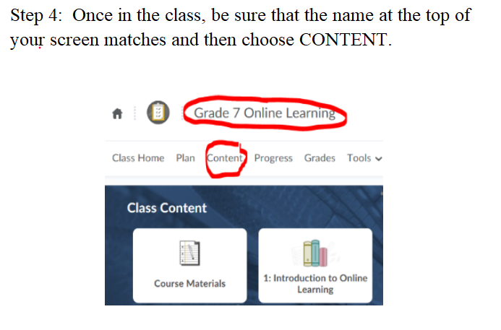

Slide 5
