Slide 1
K-5 OLS Navigation
Getting Off To A Strong Start!

Slide 2
OLS Tips and Tools
Logging into the Online School, Account Set Up.
Checking email.
Finding Class Connect sessions.
Courses, Lessons, and the Weekly Plan.
Checking Progress
Learning Coach Page

Slide 3
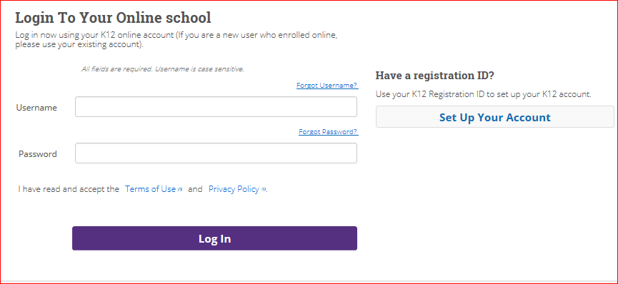
Click here to set up Student and Learning Coach Accounts
To Log into the Online School enter you students username and password. If you have not set up an account yet please click the Set Up Your Account button and follow the steps provided.

Slide 4
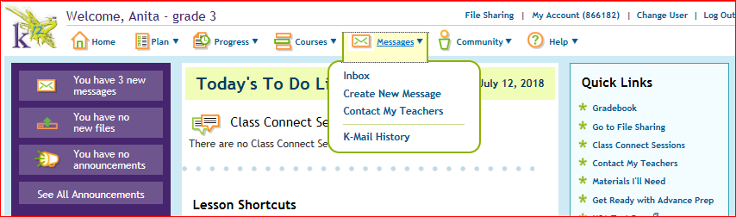
Make sure you see the students name in the top left when you log in. If you are in the Learning Coach account you will see the LC’s Name
Any emails in your student account Inbox will be displayed here.
Please check your email several times
a day to ensure you are receiving all
correspondence from the school.
You can also find student emails by clicking on the message tab and then selecting Inbox.

Slide 5
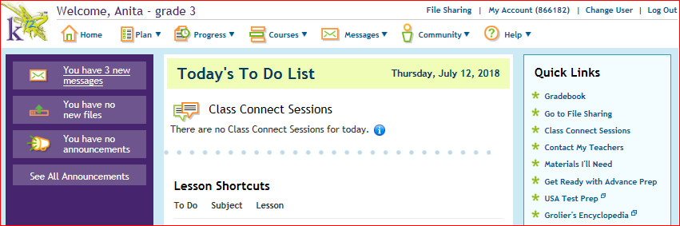
Selecting the plan tab and then selecting class connects will display all classes.
Class Connect Sessions will be listed here daily.
You can access Class
Connects from several
locations.
You can access your class connects from the additional Quick Links menu.

Slide 6
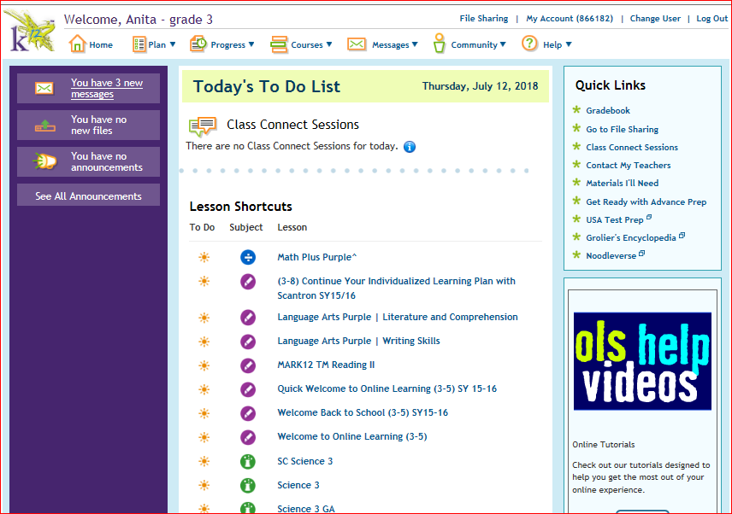
Finding Courses In The OLS, Using The Lesson Shortcut!
All of your courses will be listed under the Lesson Shortcuts. When you select what course you would like to work in the correct lesson will appear.

Slide 7
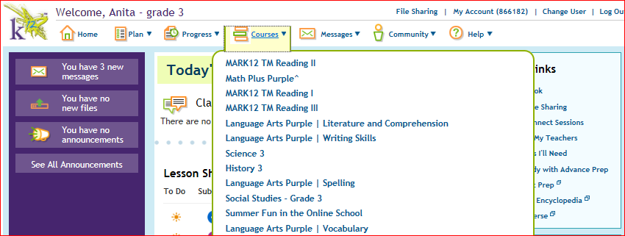
Accessing Lessons From the Course Tab and the Online K-8 Learning Course.
Clicking the course tab will give you a drop down menu with all of your courses. You can access all lessons from this tab. This is where you will locate the Online K-8 Learning Course that must be completed the first week of school.

Slide 8
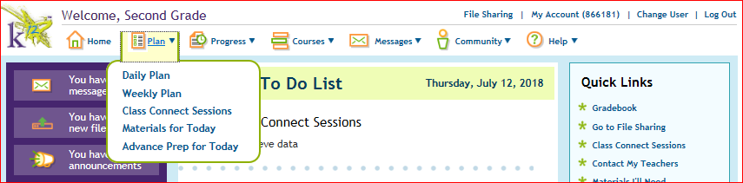
Finding the Daily and Weekly Plan.
Click the plan tab to find your students Daily and Weekly Plans. This will give you a list of all lessons and class connects that should be completed for the day or week.
It is very important to check the students daily or weekly plan everyday to make sure no changes have occurred and to verify that work is being completed.
Weekly Plan View
Daily Plan View

Slide 9
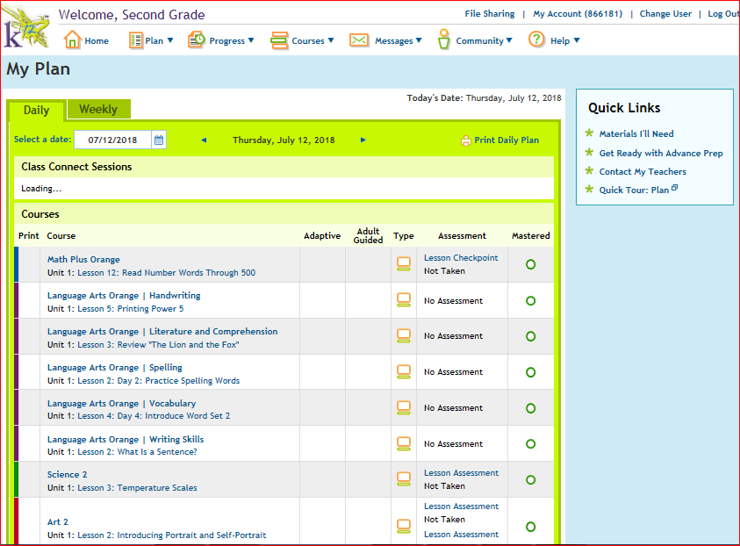
OLS Daily Plan.
The daily plan will show the
lessons and class connects that
need to be completed for that
day. You can click on any lesson
listed and begin working.

Slide 10
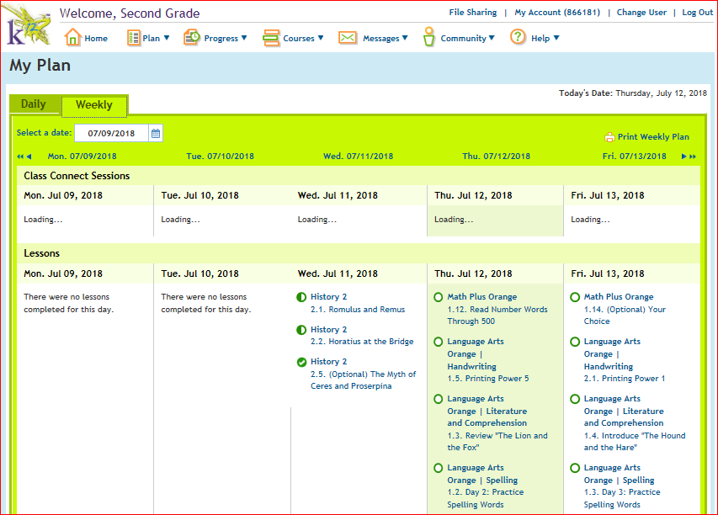
OLS Weekly Plan.
Half circles mean the lesson has been started but not finished or mastered. These lessons need to be retaken, until you receive a green check mark.
The weekly plan will show all lessons and class connects scheduled for the week.
Green check marks are what you want to see, this means the lesson has been completed.
Blank circles mean the lesson has not been opened or completed.

Slide 11
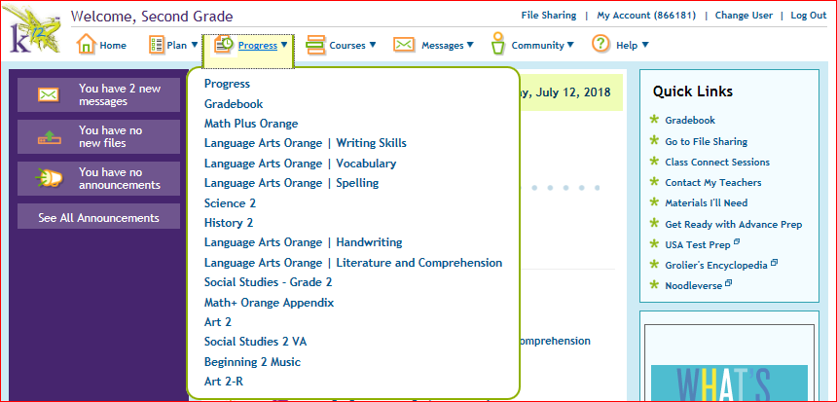
Checking Student Progress.
Select the Progress tab in the OLS. This will give you access to view all progress or progress by subject.
Learning Coaches should be checking the students progress everyday. If progress in not increasing then lessons
are not being completed.

Slide 12
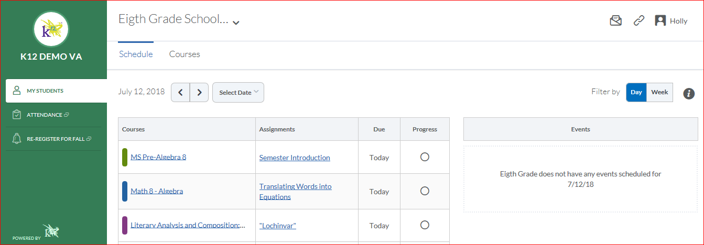
Learning Coach Page and Tools.
If you have multiple students select the student you wish to view from the drop down.
The Learning
Coach view gives you the ability to
view the students schedule, courses, and to check lesson
completion.
Select the day or week view.
Select schedule to view the students lesson for the day or week.
Students lesson will appear here. Remember to make sure the circle has a green check.

Slide 13
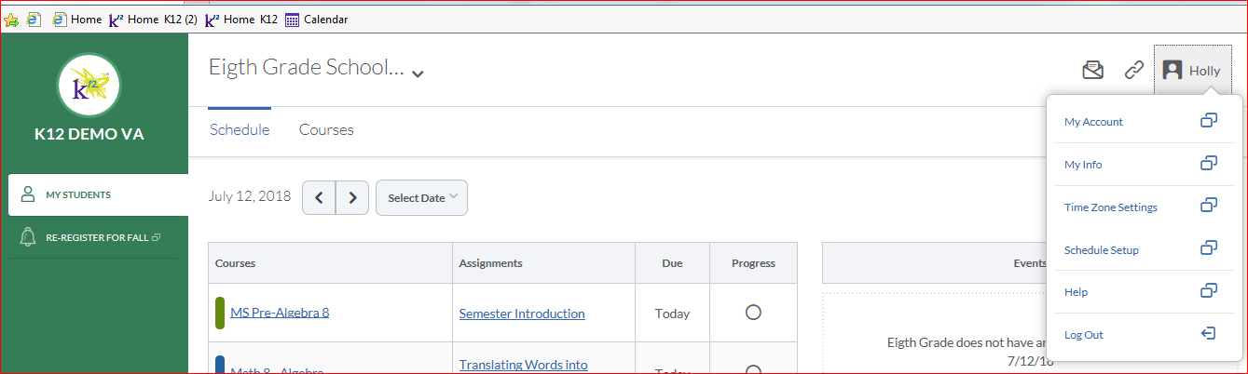
Select the My Info tab to find out information about materials being shipped, and other student details.
If your time zones don’t match click here to change settings.
Select the Schedule Set Up tab to adjust your students daily and weekly plans.
Select your name in the top right corner to check on material shipments, account info, schedule setup, and time zone changes.

Slide 14
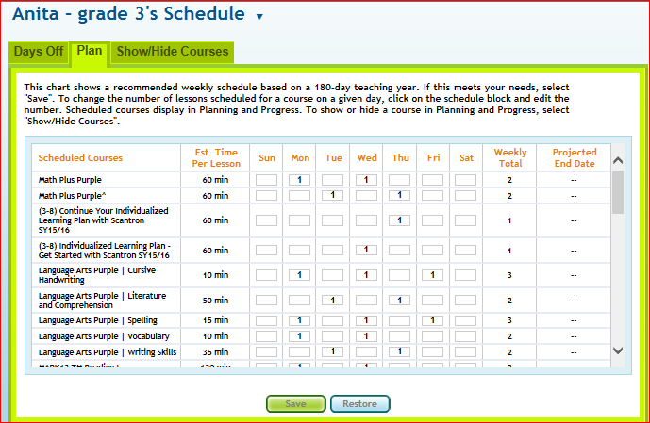
After selecting the Schedule Setup you can adjust the number of lessons your student completes daily and weekly to match what the teacher would like completed.

Slide 15
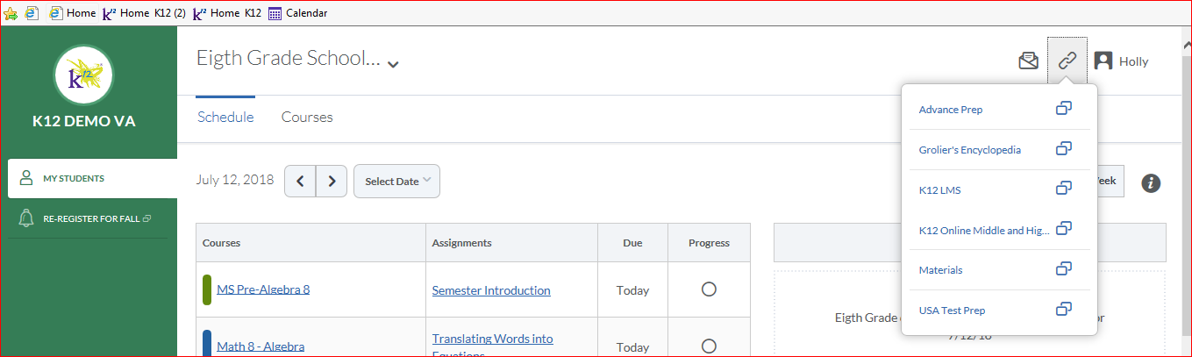
Select K12LMS to return to the students page in the OLS.
Clicking on the chain symbol in the top right corner will allow you to toggle from your Learning Coach page to your student page without having to log out of the school.

Slide 16
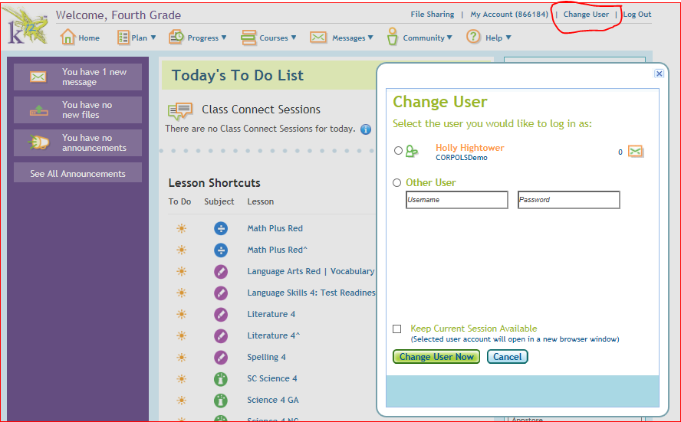
To change the user while in the students OLS account, select
Change User in the top right corner.
Select your name and enter your Learning Coach password, then click the Change User Now button. This will take you to the Learning Coach page.

Slide 17
THIS CONCLUDES THE PRESENTATION. PLEASE LET ME KNOW IF YOU NEED
ADDITIONAL HELP OR HAVE ANY QUESTIONS. I HOPE THIS HELPS YOU TO
BE ABLE TO NAVIGATE A LITTLE EASIER THROUGH THE ONLINE SCHOOL.
HAVE A GREAT DAY!
ENGAGEMENT COACH,
Haley Woodruff
IF YOU HAVE TECHNICAL ISSUES PLEASE CONTACT K12 TECH SUPPORT AT
1866-K12-CARE.

Slide 18
Add a Slide Title - 2

Slide 19
Add a Slide Title - 3

Slide 21
Add a Slide Title - 4

